Slide 1
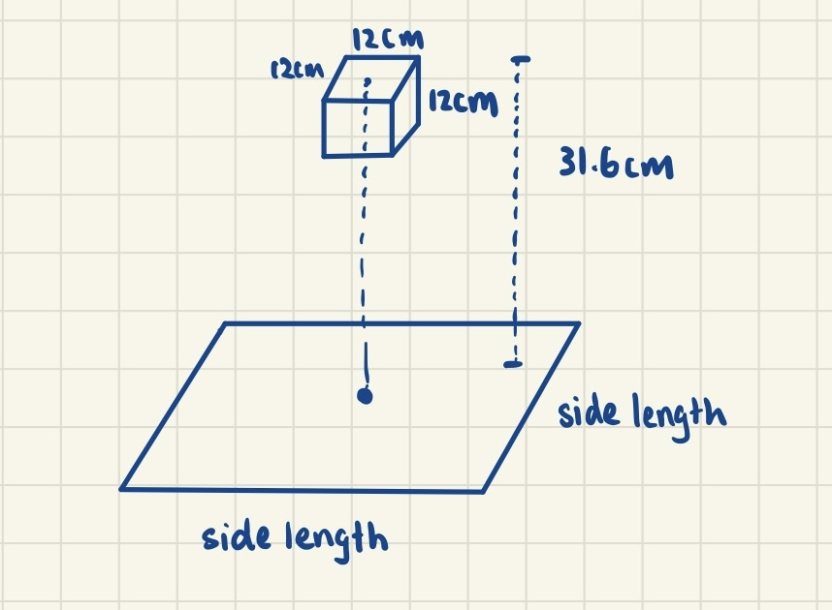
Settings
Heart size: length * width * depth - 12cm * 8cm * 6cm
Bounding box for the heart: 12cm * 12cm * 12cm
99 percentile of male solders’ chest depth: 31.6cm

Slide 2
Settings
Side length = 0.04:0.04:20 m
Magnet’s configurations: All the combinations between
x = [-0.06, 0, 0.06] m
y = [-0.06, 0, 0.06] m
z = [0.196, 0.256, 0.316] m
Theta (Rotation around the x-axis)= [-pi/2, -pi/4, 0, pi/4, pi/2] rad
Phi (Rotation around the y-axis)= [-pi/2, -pi/4, 0, pi/4, pi/2] rad
Note: we are still specifying the orientation with Euler angles, but when we compute the Jacobian, we compute it with respect to the rotation matrix.

Slide 3
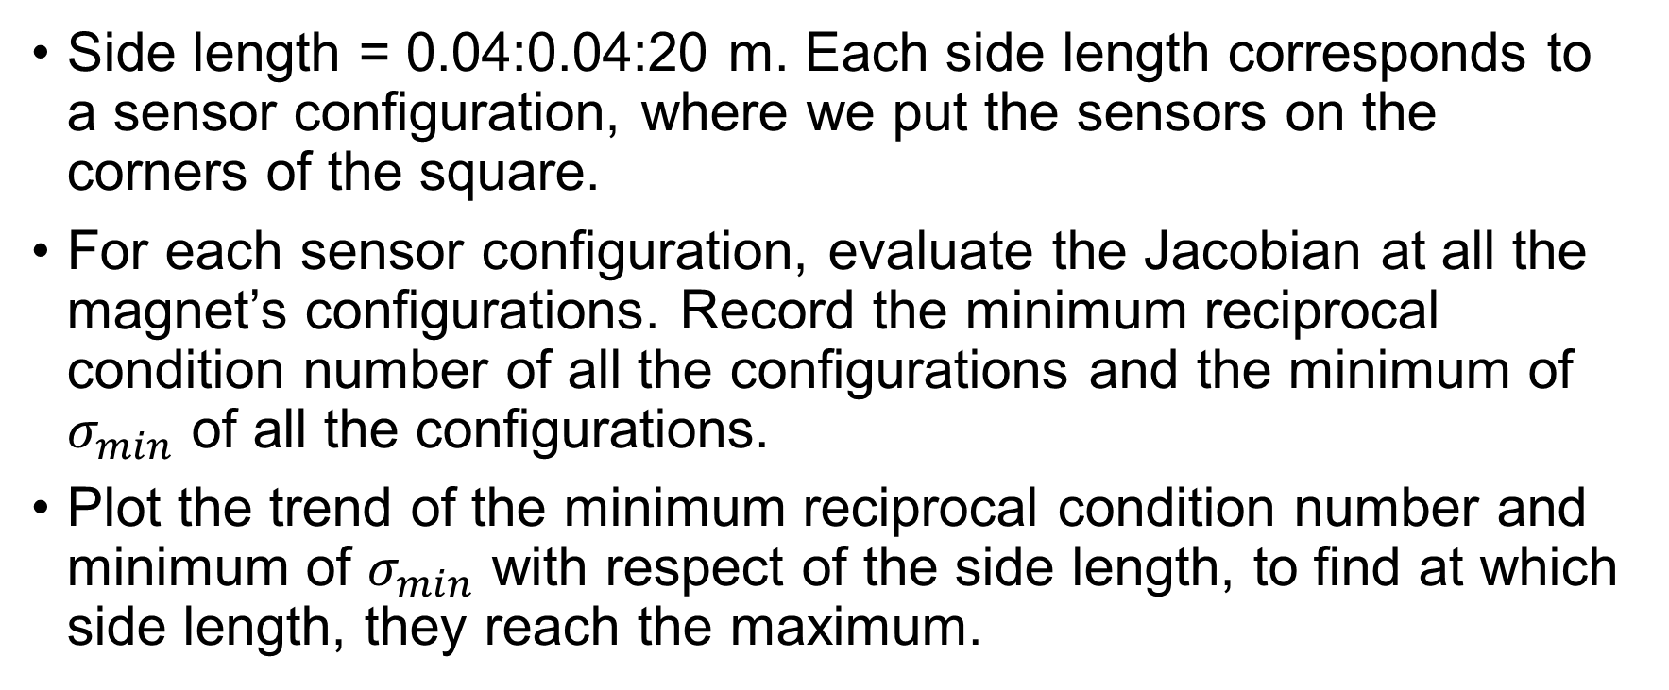
Settings
Side length = 0.04:0.04:20 m. Each side length corresponds to a sensor configuration, where we put the sensors on the corners of the square.
For each sensor configuration, evaluate the Jacobian at all the magnet’s configurations. Record the minimum reciprocal condition number of all the configurations and the minimum of $σ_{min}$ of all the configurations.
Plot the trend of the minimum reciprocal condition number and minimum of $σ_{min}$ with respect of the side length, to find at which side length, they reach the maximum.

Slide 4
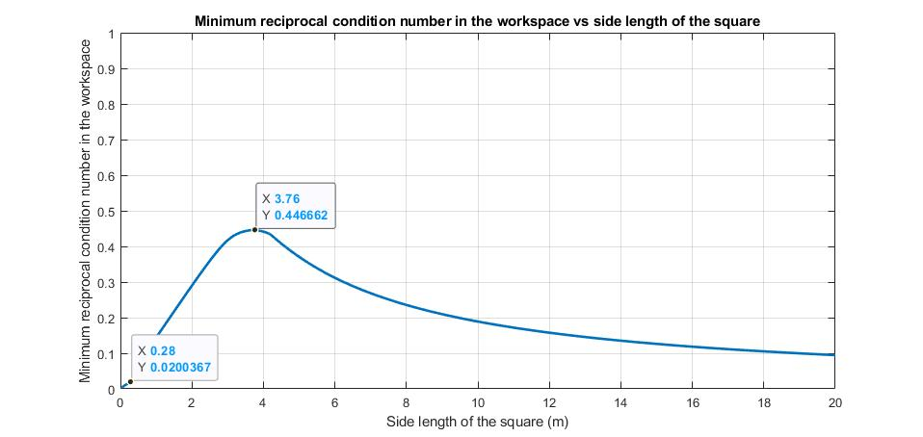
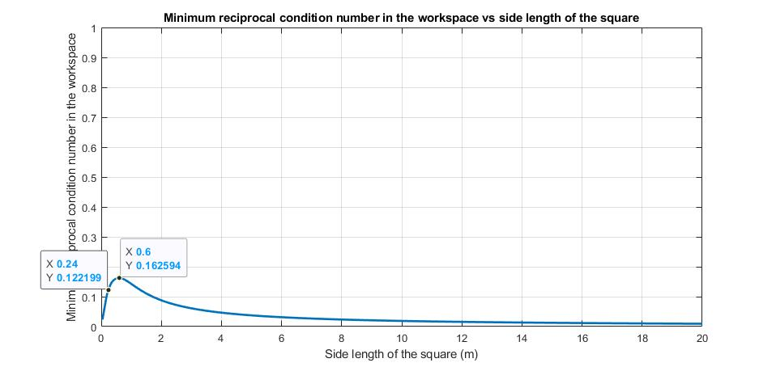
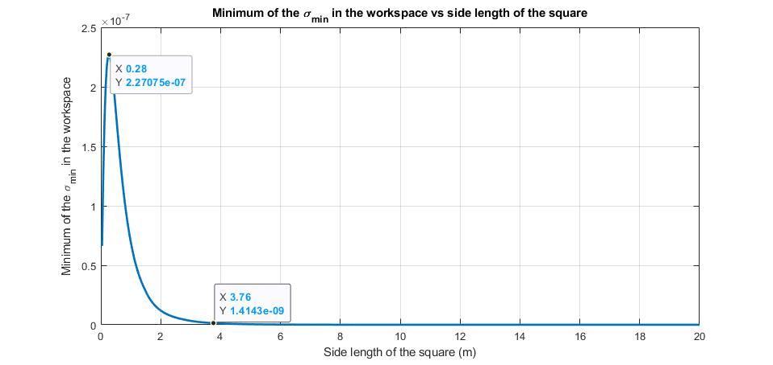
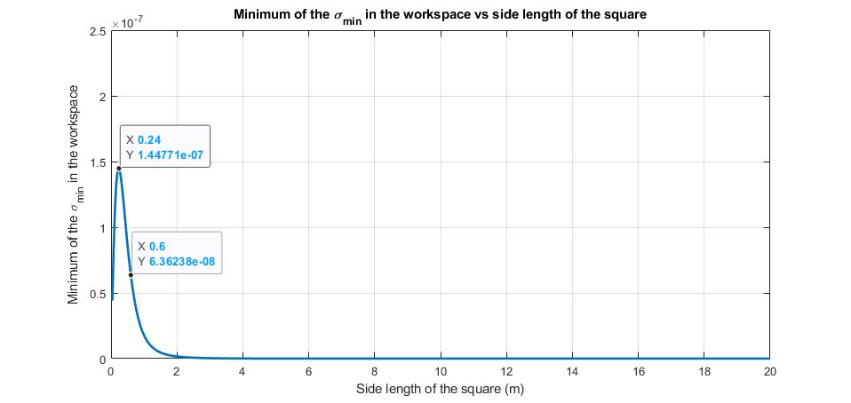
Results
Using a different unit for the distance brings the maximum of both criteria closer but also brings down the maximum they can reach.
Unscaled (using meter for distance)
Scaled (using decimeter for distance)

